Slide 1
FACE MASK DETECTION USING CNN
TEAM MEMBERS : JAYAPRAKASH REDDY KANCHARLA(700756965)
BALARITHIK REDDY GADE(700752869)
SAI SACHERITH REDDY THOODI(700754106)
YASHWANTH DUMPALA(700759472)

Slide 2
ROLE/RESPONSIBILITIES AND CONTRIBUTION IN PROJECT
There are two CNN models in use. One is for predicting the image's facial keypoints. At this point, there are 20 key points plotted around the person's face. Another CNN is used to predict the person based on the calculated ratios and angles.
A convolutional neural network (CNN) is a type of artificial neural network used primarily for image recognition and processing, due to its ability to recognize patterns in images.
CNN image classification has revolutionized the field of computer vision, enabling accurate recognition of objects within images.

Slide 3
MOTIVATION
An extremely study conducted on available face-related datasets reveal that there exist principally two kinds of datasets. They are i)masked face and ii)unmasked face. If any pandemic occurs like covid in the near future that would be very helpful for detecting whether a person is wearing a mask or not very easily . The masked face datasets are more concentrated on including the face images with a variant degree of facial expression and land marks whereas face mask centric datasets include those images of faces that are characterised by occlusions and their positional coordinates.
By using this cnn this would help in getting the better accuracy.

Slide 4
OBJECTIVES
To analyse the face images and extract useful recognition information from them which are always called as feature vector that is used to distinguish the biological features.
In fact, the problem is reverse engineering of face detection where the face is detected using different machine learning algorithms for the purpose of security, authentication and surveillance.
The face covering helps to avoid spreading of the virus by stopping the respiratory droplets which contain viral particles.
Here in this deep learning model it eliminates some of data pre-processing that is typically involved with machine learning.

Slide 5
RELATED WORK
In they have proposed a pre-trained MobileNet with a
global pooling block for face mask detection. The preprepared
MobileNet takes a shading picture and creates a
multi-dimensional component map.
The worldwide pooling
block that has been used in the proposed model changes the
element map into an element vector of 64 highlights. At long
The softmax layer performs paired order utilizing the 64
We have assessed our proposed model on two
openly accessible datasets. Our proposed model has
accomplished 99% and 100% exactness on DS1 and DS2
The worldwide pooling block that has been utilized
in the proposed model dodges overfitting the model. Further,
the proposed model beats existing models in the quantity of
boundaries just as preparing time.

Slide 6
PROBLEM STATEMENT
To address the problem of face mask recognition in the facial images.
The suggested technique successfully recognizes the face in the image then determines whether or not it has a mask on it.

Slide 7
CONTRIBUTIONS
This paper makes the following contributions :
We apply our algorithm on a set of captured browsing sessions which contain both appropriate and inappropriate material. We measure success by our ability to detect inappropriate parts of the manually labelled data-set by using MobileNetV2. Our main contributions are our modular system architecture, as well as our manually labelled data-set, which was used for both training, validation and testing or our image detection algorithm from screenshots.
This dataset can also be used for pornography detection as the manually annotated images alsocontain image class information. Our minor contributions include the various modules for analyzing the audio, imagery , text, and video from the UI layer, each of which is addressed separately.
It can be mainly broken into visual, audio, and text formats which can further be broken down into types of damage that each category can inflict.

Slide 8
METHODOLOGY APPLIED
Feature based methods extract the features from the whole image either by encoding local image features with a visual vocabulary. Region based methods are focused on the detection regions of interest in which some characteristic content is visible. In most cases it is a skin detector that uses a RGB model to find the pixels that corresponds to skin regions. Although these methods are not as sensitive to background changes feature based ones.
MobileNetV2 is a convolutional neural network architecture that seeks to perform well on mobile devices. It is based on an inverted residual structure where the residual connections are between the bottle neck layers. The intermediate expansion layer uses lightweight depth wise convolutions to filter features as a source of non linearity. As a whole, the architecture of MobileNetV2 contains the initial fully convolution layer with 32 filters, followed by 19 residual bottle necks.
The label binarizer works by converting each label into a binary vector representation. It is a powerful tool used to convert categorical labels into binary vectors

Slide 9
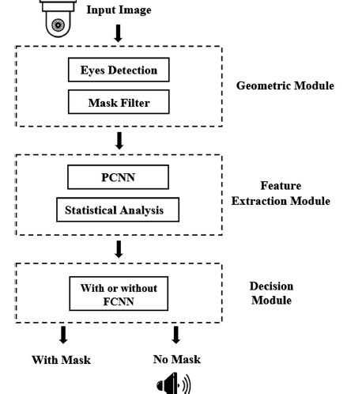
PROPOSE SOLUTION

Slide 10
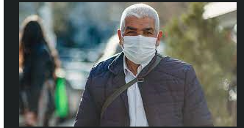
RESULTS
The person wearing the mask.

Slide 11
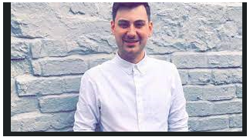
RESULTS:
The person without wearing mask.

Slide 12
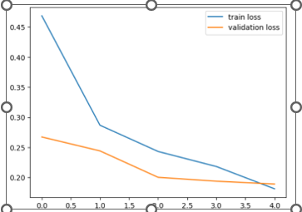
Results :

Slide 13
REFERENCES
Chollet F (2017) Xception: Deep learning with depthwise separable convolutions. In Proceedings of the IEEE conference on computer vision and pattern recognition, pp. 1251–1258
He K, Zhang X, Ren S, Sun J (2016) Deep residual learning for image recognition. In Proceedings of the IEEE conference on computer vision and pattern recognition, pp. 770–778
Roy PK, Ahmad Z, Singh JP, Alryalat MAA, Rana NP, Dwivedi YK (2018) Finding and ranking high-quality answers in community question answering sites. Global J Flex Syst Manag 19(1):53–68
Bhat S, Koundal D (2021) Multi-focus image fusion using neutrosophic based wavelet transform. Appl Soft Comput 106:107307

